Slide 1
Introduction to C
#include <stdio.h>
int main ()
{
printf(“Welcome to C Prgramming\n”);
}

Slide 2
Outline
I. Program Basics
  A. Program skeleton
    preprocessor directives
    global declarations
    functions
      local declarations
      statements
  B. Comments and Documentation
  C. Names (identifiers)
    reserved words

Slide 3
Outline (cont)
I. Program Basics (cont)
  D. Variable declarations
    1. Memory allocation
    2. Atomic types
      void, int, float, char
  E. Constants
    1. literal
    2. defined
    3. memory

Slide 4
Outline (cont)
I. Program Basics (cont)
  F. Formatted input/output
    1. Files
    2. Printf (monitor output)
      a. format strings
        field specifications
      b. data list
    3. Scanf (keyboard input)
      a. format strings
      b. address list
    4. Prompting for Input

Slide 5
History of C
1960: ALGOL (ALGOrithmic Language)
1967: BCPL (Basic Combined Programming Language)
1970: B programming language (typeless)
1972: C: BCPL plus B with types
1978: Kernighan + Ritchie standard for C
1989: ANSI standard for C

Slide 6
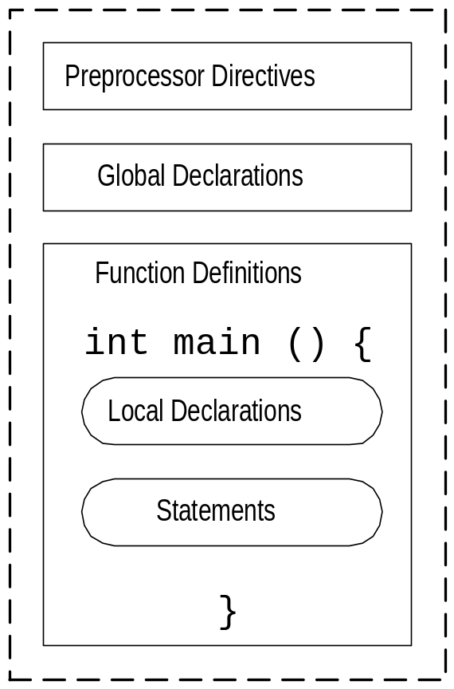
C Program Structure
Program defined by:
  global declarations
  function definitions
May contain preprocessor directives
Always has one function named main, may contain others

Slide 7
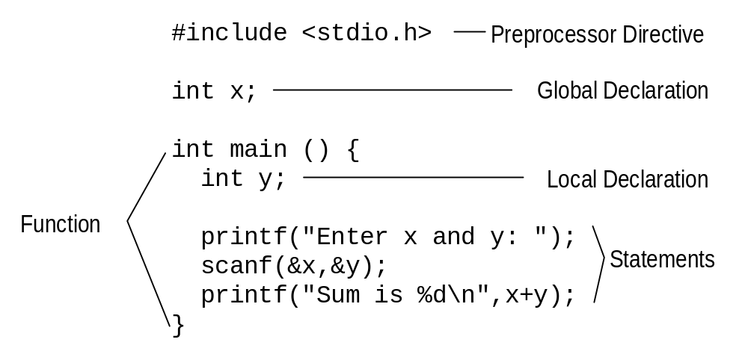
Parts of a Program

Slide 8
Preprocessor Directives
Begin with #
Instruct compiler to perform some transformation to file before compiling
Example: #include <stdio.h>
  add the header file stdio.h to this file
  .h for header file
  stdio.h defines useful input/output functions

Slide 9
Declarations
Global
  visible throughout program
  describes data used throughout program
Local
  visible within function
  describes data used only in function

Slide 10
Functions
Consists of header and body
  header: int main ()
  body: contained between { and }
    starts with location declarations
    followed by series of statements
More than one function may be defined
Functions are called (invoked) - more later

Slide 11
Main Function
Every program has one function main
Header for main: int main ()
Program is the sequence of statements between the { } following main
Statements are executed one at a time from the one immediately following to main to the one before the }

Slide 12
Comments
Text between /* and */
Used to “document” the code for the human reader
Ignored by compiler (not part of program)
Have to be careful
  comments may cover multiple lines
  ends as soon as */ encountered (so no internal comments - /* An /* internal */ comment */)

Slide 13
Comment Example
#include <stdio.h>
/* This comment covers
* multiple lines
* in the program.
*/
int main () /* The main header */ {
/* No local declarations */
printf(“Too many comments\n”);
} /* end of main */

Slide 14
Documentation
Global - start of program, outlines overall solution, may include structure chart
Module - when using separate files, indication of what each file solves
Function - inputs, return values, and logic used in defining function
Add documentation for key (tough to understand) comments
Names of variables - should be chosen to be meaningful, make program readable

Slide 15
Program Execution
Global declarations set up
Function main executed
  local declarations set up
  each statement in statement section executed
    executed in order (first to last)
    changes made by one statement affect later statements

Slide 16
Syntax of C
Rules that define C language
  Specify which tokens are valid
  Also indicate the expected order of tokens
Some types of tokens:
  reserved words: include printf int ...
  identifiers: x y ...
  literal constants: 5 ‘a’ 5.0 ...
  punctuation: { } ; < > # /* */

Slide 17
Identifier
Names used for objects in C
Rules for identifiers in C:
  first char alphabetic [a-z,A-Z] or underscore (_)
  has only alphabetic, digit, underscore chars
  first 31 characters are significant
  cannot duplicate a reserved word
  case (upper/lower) matters

Slide 18
Reserved Words (Keywords)
Identifiers that already have meaning in C
Examples:
  include, main, printf, scanf, if, else, …
  more as we cover C language

Slide 19
Valid/Invalid Identifiers
Valid
sum
c4_5
A_NUMBER
longnamewithmanychars
TRUE
_split_name
Invalid
7of9
x-name
name with spaces
1234a
int
AXYZ&

Slide 20
Variables
Named memory location
Variables are declared in global or local declaration sections
Syntax: Type Name;
Examples:
  int sum;
  float avg;
  char dummy;

Slide 21
Variable Type
Indicates how much memory to set aside for the variable
Also determines how that space will be interpreted
Basic types: char, int, float
  specify amount of space (bytes) to set aside
  what can be stored in that space
  what operations can be performed on those vars

Slide 22
Variable Name
Legal identifier
Not a reserved word
Must be unique:
  not used before
  variable names in functions (local declarations) considered to be qualified by function name
  variable x in function main is different from x in function f1

Slide 23
Multiple Variable Declarations
Can create multiple variables of the same type in one statement:
  int x, y, z;
  is a shorthand for
  int x;
  int y;
  int z;
  - stylistically, the latter is often preferable

Slide 24
Variable Initialization
Giving a variable an initial value
Variables not necessarily initialized when declared (value is unpredictable - garbage)
Can initialize in declaration:
Syntax: Type Name = Value;
Example:
  int x = 0;

Slide 25
Initialization Values
Literal constant (token representing a value, like 5 representing the integer 5)
An expression (operation that calculates a value)
Function call
The value, however specified, must be of the correct type

Slide 26
Multiple Declaration Initialization
Can provide one value for variables initialized in one statement:
  int x, y, z = 0;
Each variable declared and then initialized with the value

Slide 27
Type
Set of possible values
  defines size, how values stored, interpreted
Operations that can be performed on those possible values
Data types are associated with objects in C (variables, functions, etc.)

Slide 28
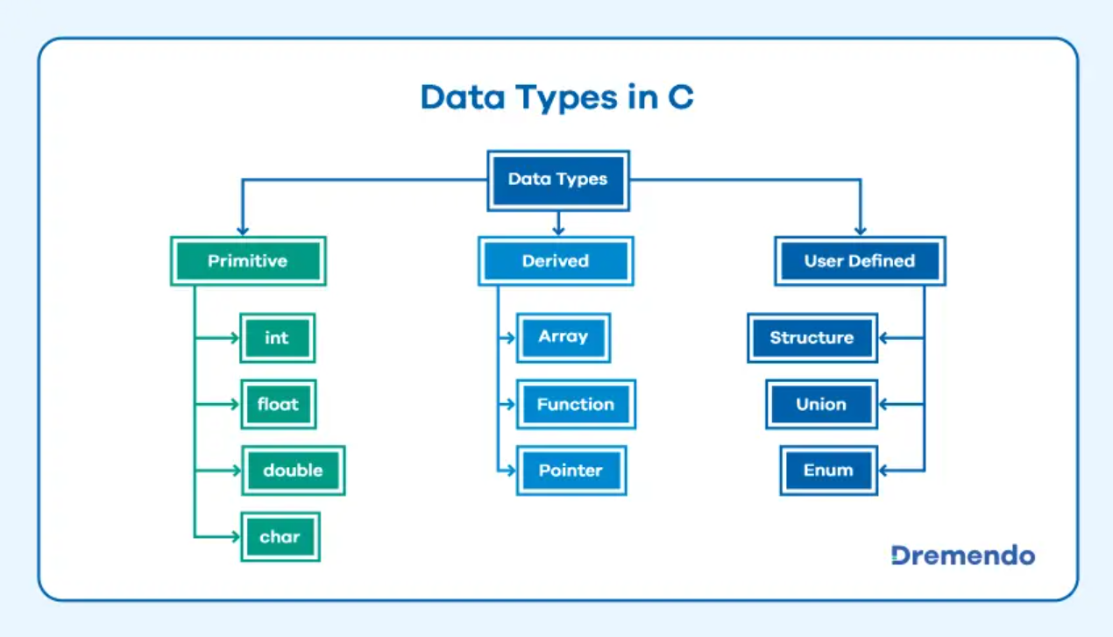

Slide 29
Standard Types
Atomic types (cannot be broken down)
  void
  char
  int
  float, double
Derived types
  composed of other types

Slide 30
Literal Constants
Sequences of characters (tokens) that correspond to values from that type
  -35 is the integer -35
  3.14159 is the floating pointer number 3.14159
  ‘A’ is the character A
Can be used to initialize variables

Slide 31
Void Type
Type name: void
Possible values: none
Operations: none
Useful as a placeholder

Slide 32
Integer Type
Type name:
  int
  short int
  long int
Possible values: whole numbers (within given ranges) as in 5, -35, 401
Operations: arithmetic (addition, subtraction, multiplication, …), and others

Slide 33
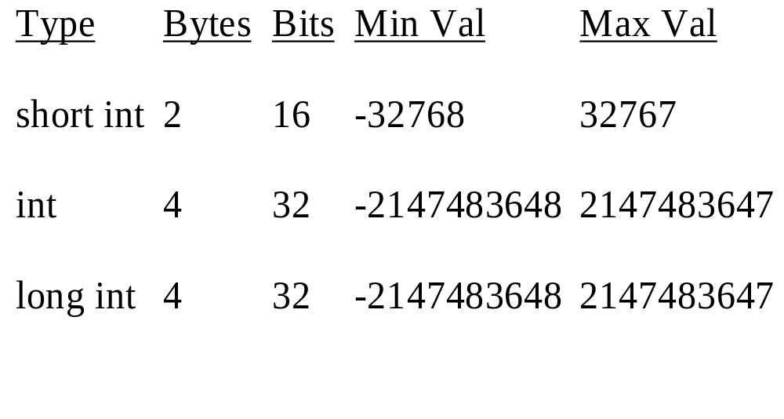
Integer Types/Values

Slide 34
Why Limited?
With a fixed number of bits, only a certain number of possible patterns
16 bits, 65,536 possible patterns
  32768 negative numbers
  1 zero
  32767 positive numbers
Overflow: attempt to store a value to large in a variable (40000 in short int)

Slide 35
Unsigned Integers
Type: unsigned int
No negative values
unsigned int:
  possible values: 0 to 65536
Representation: binary number

Slide 36
Integer Literal Constants
Syntax:
  1 or more digits
  Optional leading sign (+ or -)
  Optional l or L at the end for long
  Optional u or U for unsigned
Examples:
  5, -35, 401, 4010L, -350L, 2000UL

Slide 37
Floating-Point Type
Type names:
  float
  double
  long double
Possible values: floating point numbers, 5.0 -3.5, 4.01
Operations: arithmetic (addition, subtraction, multiplication, …), and others

Slide 38
Floating-Point Representation
float: 4 bytes, 32 bits
double: 8 bytes, 64 bits
long double: 10 bytes, 80 bits
Representation:
  magnitude (some number of bits) plus exponent (remainder of bits)
  3.26 * 10^4 for 32600.0

Slide 39
Floating-Point Literals
Syntax:
  Zero or more digits, decimal point, then zero or more digits (at least one digit)
  Whole numbers also treated as float
  Optional sign at start
  Can be followed by e and whole number (to represent exponent)
  f or F at end for float
  l or L at end for long double
Examples: 5, .5, 0.5, -1.0, 2.1e+3, 5.1f

Slide 40
Character Type
Type name: char
Possible values: keys that can be typed at the keyboard
Representation: each character assigned a value (ASCII values), 8 bits
  A - binary number 65
  a - binary number 97
  b - binary number 98
  2 - binary number 50

Slide 41
Character Literals
Single key stroke between quote char ‘
Examples: ‘A’, ‘a’, ‘b’, ‘1’, ‘@’
Some special chars:
  ‘\0’ - null char
  ‘\t’ - tab char
  ‘\n’ - newline char
  ‘\’’ - single quote char
  ‘\\’ - backslash char

Slide 42
String Literals
No string type (more later)
Contained between double quote chars (“)
Examples:
  “” - null string
  “A string”
  “String with newline \n char in it”
  “String with a double quote \” in it”

Slide 43
Constants
Literal constants - tokens representing values from type
Defined constants
  syntax: #define Name Value
  preprocessor command, Name replaced by Value in program
  example: #define MAX_NUMBER 100

Slide 44
Constants (cont)
Memory constants
  declared similar to variables, type and name
  const added before declaration
  Example: const float PI = 3.14159;
  Can be used as a variable, but one that cannot be changed
  Since the value cannot be changed, it must be initialized

Slide 45
Formatted Input/Output
Input comes from files
Output sent to files
Other objects treated like files:
  keyboard - standard input file (stdin)
  monitor - standard output file (stdout)
Generally send/retrieve characters to/from files

Slide 46
Formatted Output
Command: printf - print formatted
Syntax: printf(Format_String, Data List/Argument list);
  Format string any legal string
  Characters sent (in order) to screen
Ex.: printf(“Welcome to\nCS 1621!\n”);
  causes
  Welcome to
  CS 1621!
  to appear on monitor

Slide 47
Formatted Output (cont)
Successive printf commands cause output to be added to previous output
Ex.
  printf(“Hi, how “);
  printf(“is it going\nin 1621?”);
  prints
  Hi, how is it going
  in 1621?
  To the monitor

Slide 48
Field Specifications
Format string may contain one or more field specifications
  Syntax: %[Flag][Width][Prec][Size]specifier
  Specifiers:
    c - data printed as character
    d - data printed as integer
    f - data printed as floating-point value
  For each field specification, have one data value after format string, separated by commas

Slide 49
Field Specification Example
printf(“%c %d %f\n”,’A’,35,4.5);
produces
A 35 4.50000
(varies on different computers)
Can have variables in place of literal constants (value of variable printed)

Slide 50
Width and Precision
When printing numbers, generally use width/precision to determine format
  Width: how many character spaces to use in printing the field (minimum, if more needed, more used)
  Precision: for floating point numbers, how many characters appear after the decimal point, width counts decimal point, number of digits after decimal, remainder before decimal

Slide 51
Width/Precision Example
printf(“%5d% 8.3f\n”,753,4.1678);
  produces
  753 4.168
  values are right justified
If not enough characters in width, minimum number used
  use 1 width to indicate minimum number of chars should be used

Slide 52
Left Justification (Flags)
Put - after % to indicate value is left justified
  printf(“%-5d%-8.3fX\n”,753,4.1678);
  produces
  753 4.168 X
For integers, put 0 after % to indicate should pad with 0’s
  printf(“%05d”,753);
  produces
  00753

Slide 53
Size Indicator
Use hd for small integers
Use ld for long integers
Use Lf for long double
Determines how value is treated

Slide 54
Printf Notes
Important to have one value for each field specification
  some C versions allow you to give too few values (garbage values are formatted and printed)
Values converted to proper type
  printf(“%c”,97); produces the character a on the screen

Slide 55
Formatted Input
Command: scanf - scan formatted
Syntax: scanf(Format String, Address List);
  Format string a string with one or more field specifications
  Characters read from keyboard, stored in variables
scanf(“%s %d %f”,&cVar,&dVar,&fVar);
  attempts to read first a single character, then a whole number, then a floating point number from the keyboard

Slide 56
Formatted Input (cont)
Generally only have field specifications and spaces in string
  any other character must be matched exactly (user must type that char or chars)
  space characters indicate white-space is ignored
  “white-space” - spaces, tabs, newlines
  %d and %f generally ignore leading white space anyway (looking for numbers)
  %d and %f read until next non-number char reached

Slide 57
Formatted Input (cont)
More notes
  can use width in field specifications to indicate max number of characters to read for number
  computer will not read input until return typed
  if not enough input on this line, next line read, (and line after, etc.)
  inappropriate chars result in run-time errors (x when number expected)
  if end-of-file occurs while variable being read, an error occurs

Slide 58
Address Operator
& - address operator
Put before a variable (as in &x)
Tells the computer to store the value read at the location of the variable
More on address operators later

Slide 59
Scanf Rules
Conversion process continues until
  end of file reached
  maximum number of characters processed
  non-number char found number processed
  an error is detected (inappropriate char)
Field specification for each variable
Variable address for each field spec.
Any character other than whitespace must be matched exactly

Slide 60
Scanf Example
scanf(“%d%c %f”,&x,&c,&y);
and following typed:
-543A
4.056 56
-543 stored in x, A stored in c, 4.056 stored in y, space and 56 still waiting (for next scanf)

Slide 61
Prompting for Input
Using output statements to inform the user what information is needed:
  printf(“Enter an integer: “);
  scanf(“%d”,&intToRead);
Output statement provides a cue to the user:
  Enter an integer: user types here

